Slide 1

REVIEW 3 - SOFTWARE CONSTRUCTION ANDMAINTAINANCE
TITLE - CARBON FOOTPRINT

Slide 2

TEAM MEMBERS AND THEIR CONTRIBUTION:-
RAJ KOYANI - 21MIS1017
CODING
IMPLEMENTATION
PRESENTATION
2. ANEESH H VISHWAMITRA - 21MIS1030
CODING
IMPLEMENTATION
PRESENTATION
3. VAISHNAVI SHUKLA - 21MIS1100
RESEARCH
DOCUMENTATION
PRESENTATION

Slide 3

PROBLEM STATEMENT:-
THE GROWING ATTENTION OF CARBON DIOXIDE AND DIFFERENT GREENHOUSE GASES WITHIN THE EARTH'S ECOSYSTEM, IN LARGE PART RESULTING FROM HUMAN SPORTS CONSISTING OF BURNING OF FOSSIL FUELS AND DEFORESTATION, IS RESULTING IN A SLOW HOWEVER CONSISTENT RISE IN INTERNATIONAL TEMPERATURES AND OTHER CLIMATE ADJUSTMENTS. THOSE CHANGES HAVE CRITICAL IMPLICATIONS FOR THE ENVIRONMENT, TOGETHER WITH SEA LEVEL UPWARD THRUST, EXCESSIVE CLIMATE EVENTS, AND LOSS OF BIODIVERSITY, AMONGST OTHERS.
THEREFORE, THE HASSLE OF CARBON EMISSIONS CAN BE DESCRIBED AS THE WANT TO NOTICEABLY REDUCE THE AMOUNT OF CARBON DIOXIDE AND OTHER GREENHOUSE GASES THAT ARE LAUNCHED INTO THE ECOSYSTEM THAT ALLOWS YOU TO MITIGATE THE HARMFUL EFFECTS OF CLIMATE TRADE AND PROMOTE A EXTRA SUSTAINABLE FUTURE FOR THE PLANET AND ITS INHABITANTS. THIS CALLS FOR A MULTI-FACETED METHOD THAT ENTAILS NOT SIMPLEST DECREASING EMISSIONS FROM VARIOUS ASSETS, HOWEVER ALSO GROWING AND IMPLEMENTING ALTERNATIVE POWER SOURCES AND SELLING SUSTAINABLE PRACTICES ACROSS ALL SECTORS OF SOCIETY.

Slide 4
ABSTRACT:-
The main goal of this Carbon emission and monitoring venture is to calculate the Carbon footprint, and rate of pollution in a city with this task we can control pollutants in a town. It additionally enables people and organizations to measure the amount of greenhouse gas emissions they produce and pick out ways to lessen their carbon footprint. This software program works with the aid of accumulating facts on diverse sports, along with transportation or traveling evaluation by way of getting into kind of automobile and day-by-day average strolling distance, energy use via coming into annual strength intake and annual LPG consumption, and waste disposal, food intake evaluation by using every kind of food fed on each yr in (kg/week), after which using those statistics to calculate an estimate of the carbon emissions associated with the one's sports.

Slide 5
There are several ability demerits related to present carbon footprint calculator apps:
Inaccuracies: Many carbon footprint calculators depend on generalized information and estimates, which won't appropriately reflect an individual's particular instances or conduct. Some carbon footprint calculators best recall a slim set of activities, along with household power use or personal transportation.
Lack of transparency: a few carbon footprint calculators might not divulge the records sources or assumptions underlying their calculations, making it hard for users to assess the accuracy of the consequences.
2. Incomplete assessment: Many carbon footprint calculators no longer don't forget the total lifecycle of products or services, such as the emissions related to manufacturing, transportation, and disposal.
3. Cognizance on personal action: while people need to lessen their carbon footprints, whether the trade is a systemic problem that calls for collective movement at a societal and political stage.
Benchmarks in the carbon footprint calculator app are a comparison device to help customers apprehend how their carbon footprint measures up in opposition to a standard or common consisting of:-
Countrywide averages are based totally on the average carbon footprint of a person in a selected us of a region.

Slide 6
PROJECT OBJECTIVES
The main objective of a carbon footprint calculator app is to help individuals and businesses understand the carbon emissions associated with their activities, and identify areas wherein they can make adjustments to lessen their impact on the surroundings. Right here are some particular objectives of a carbon footprint calculator app:
Measure carbon emissions: The app must correctly measure the carbon emissions related to various sports, together with transportation, strength intake, and food manufacturing.
2. Provide insights: The app ought to provide insights into the carbon emissions associated with one-of-a-kind sports, and assist customers recognize the relative impact of diverse movements on the surroundings.
3. Perceive areas for development: The app need to assist users identify areas in which they could make adjustments to reduce their carbon footprint, such as by way of decreasing strength consumption, switching to renewable strength resources, or the usage of alternative transportation techniques.

Slide 7
4. Set dreams: The app should help customers set practical desires for lowering their carbon footprint, and provide remarks on their progress towards those dreams.
5. Boost consciousness: The app must raise recognition about the importance of reducing carbon emissions and sell sustainable behaviors among users.
6. Overall, the targets of a carbon footprint calculator app are to assist users understand their impact on the surroundings and take movement toward a more sustainable future.

Slide 8
INTRODUCTION:-
The carbon footprint calculator app works by estimating the number of greenhouse gases emitted as a result of a person's sports. The app uses a calculation methodology that takes into consideration the average quantity of carbon dioxide (CO2) and other greenhouse gases emitted due to these activities based totally on information from clinical studies, enterprise requirements, and government reports. Primarily based on the consumer's responses, the app generates a record that estimates the user's carbon footprint, normally measured in metric lots of CO2 equal and consistent with 12 months
The significance of carbon footprint lies in its impact on weather exchange and the surroundings which include rising sea levels, extra common and extreme natural failures, and adjustments in ecosystems and biodiversity. Decreasing our carbon footprint can assist mitigate the outcomes of weather alternate by way of decreasing the number of greenhouse gases launched into the environment.
There are several blessings of the use of it such as recognition, Personalization, intention putting, schooling, and network engagement.

Slide 9
LITERATURE REVIEW:-
This study compares and evaluates the accuracy, usefulness, and effectiveness of several carbon footprint calculator apps on the market. The study evaluates the calculators' data sources, calculation algorithms, user interfaces, and functions to provide insight into their overall performance. It also examines the engagement and user experience of Carbon Footprint Calculator applications. It examines how user interface design, interactivity, and gameplay elements influence user motivation and behavioral change. The study offers recommendations to improve the usability of these applications and examines the effectiveness of carbon footprint calculators in promoting sustainable living. It analyzes behavioral changes and user awareness caused by these programs. The study also examines the influence of personal feedback and social contacts on long-term decision-making. The subject of this assessment is the reliability and validity of the data in the Carbon Footprint Calculator applications. It examines the data sources used by these applications, evaluates the accuracy of calculations, and handles data validation. The study offers suggestions for improving the data quality of such applications. This study investigates the possibility of personalized recommendations in carbon footprint calculator applications. It examines the impact of personalization of recommendations on user behavior and preferences, highlights the importance of personalization in promoting sustainable behavior, and suggests successful personalization options.

Slide 10
This study explores the potential of carbon footprint calculators to inform and encourage people to take action to combat climate change. It examines how the social costs of carbon affect user behavior and decision-making. The study sheds light on the limitations and opportunities of such applications in the fight against climate change. The purpose of this study is to evaluate the usefulness of carbon footprint calculators to manage the sustainable development of companies. It explores the requirements and barriers to adopting such applications in business environments. The study examines the potential advantages and disadvantages of using such applications in terms of sustainable business development. This experimental study investigates the impact of game tactics on carbon footprint calculators. It evaluates the impact of a game where users can track their carbon footprint over time and set reduction goals. To encourage and encourage users to make sustainable decisions, the app may include visualizations and progress updates. Many carbon footprint calculator apps include educational materials to help people understand climate change, carbon footprint, and sustainability. This may include informing about the environmental impacts of various activities and recommending alternative options. elements of user engagement and behavior change. The study offers recommendations for creating effective game elements for such applications.

Slide 11
REFERENCES:-
https://www.researchgate.net/publication/329547708_The_state_of_carbon_footprint_calculators_An_evaluation_of_calculator_design_and_user_interaction_features.
https://dl.acm.org/doi/fullHtml/10.1145/3546155.3546668
https://www.mdpi.com/2071-1050/12/4/1629
https://www.ncbi.nlm.nih.gov/pmc/articles/PMC9516983/
https://www.researchgate.net/publication/369103060_A_novel_privacy-aware_global_infrastructure_for_ecological_footprint_calculator_GIEFC_based_on_internet_of_things_and_blockchain
https://www.researchgate.net/publication/368316762_Carbon_footprints_of_travel_to_World_Heritage_Sites_communicating_climate_to_potential_tourists_through_a_consumption-based_life-cycle_assessment
https://www.researchgate.net/publication/367660879_Carbon_Footprint_Controlling_and_Monitoring_as_a_Step_Toward_Sustainable_Urban_Development_Case_Study_Tabriz_City_Iran
https://www.researchgate.net/publication/366812940_Hanehalki_Karbon_Ayak_Izinin_Yavas_Kent_Olceginde_Irdelenmesi_Bolu_-_Mudurnu_Ornegi
https://www.researchgate.net/publication/364958929_Location_location_location_A_carbon_footprint_calculator_for_transparent_travel_to_COP27
https://www.researchgate.net/publication/370104439_Raising_awareness_of_antimicrobial_resistance_development_of_an_'antibiotic_footprint_calculator'
https://www.carbonfootprint.com/
https://www.footprintcalculator.org/
https://footprint.wwf.org.uk/
https://www.epa.gov/energy/greenhouse-gas-equivalencies-calculator
https://coolclimate.org/

Slide 12


Proposed System
In Detail

Slide 13




CARBON FOOTPRINT CALCULATOR APPLICATION
1.Login
2.Accept T&C
3.Provide personal
details
4.Provide strategic
data
5.Software will
calculate
Carbon Footprint
6. Software will
give report
and suggestion
1.1 userid
2.1 Checkbox
and continue
3.1 representative name
5.1 add 4.1+4.2+4.3 values
6.1 show total CF
(in kgs)
1.2 password
3.2 no. of members
3.3 census ID
5.2 divide value in 5.1 by no. of members
6.2 show average CF
(in kg/person)
6.3 give some
suggestions
4.1 travelling evaluation
4.2 Food consumption
evaluation
4.3 Annual energy consumption
4.1.1 2 wheeler
4.1.2 3 wheeler
4.1.3 4 wheeler
4.2.1 veg
4.2.2 non veg
4.3.1 electricity
(in kw/h)
4.3.2 LPG
(in units)
a. Type of vehicle
b. daily running average distance
(in kms)
consumption (in kgs/week)

Slide 14

IEEE TEST CASES TEMPLATE
https://docs.google.com/spreadsheets/d/1re2ASLmu6srlbK5SuR1_bYNVc5Zaac81/edit?usp=sharing&ouid=113481225423545694673&rtpof=true&sd=true

Slide 15

Module Description In Detail

Slide 16


ARCHITECTURE DIAGRAM:HIGH LEVEL DIAGRAM DETAILS
User Interface (UI): This is the front-end component that allows users to interact with the carbon footprint calculator. It could be a web application, mobile app, or a combination of both.
Authentication and Authorization: This component handles user authentication and authorization to ensure secure access to the calculator. It verifies user credentials and manages user roles and permissions.
Carbon Footprint Calculation Engine: This is the core component responsible for calculating carbon footprints based on user input. It may include different modules to calculate emissions from various sources such as energy usage, transportation, food consumption, and more. These calculations can be based on predefined factors or user-customized parameters.
Data Storage: This component manages the storage of user data, including user profiles, carbon footprint calculations, and historical data. You can use a database system to store and retrieve this information securely.

Slide 17

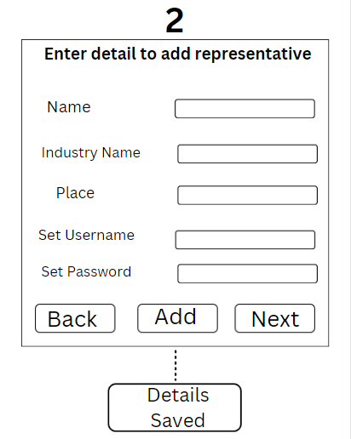
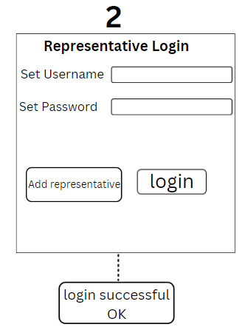
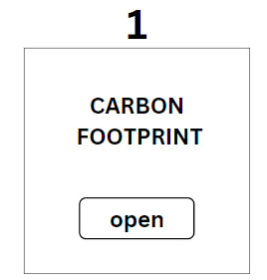
High Level Design

Slide 18
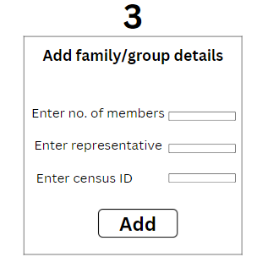
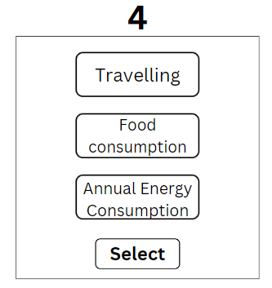
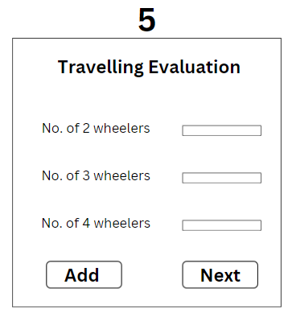
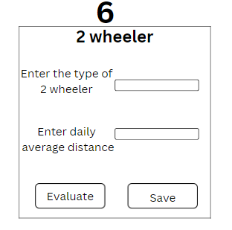
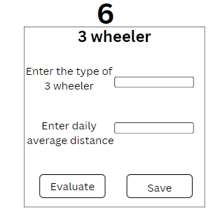
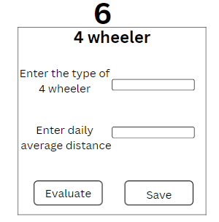

Slide 19
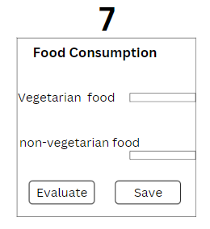
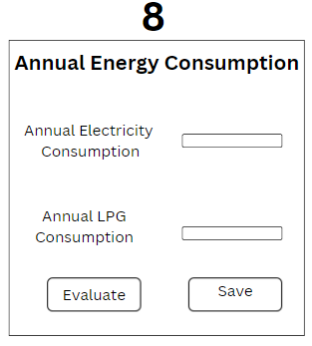
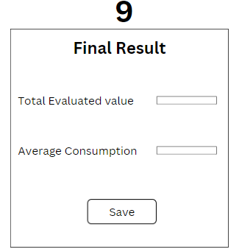

Slide 20
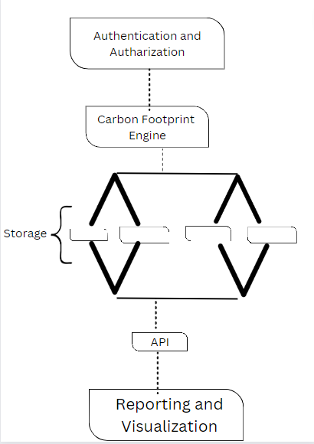
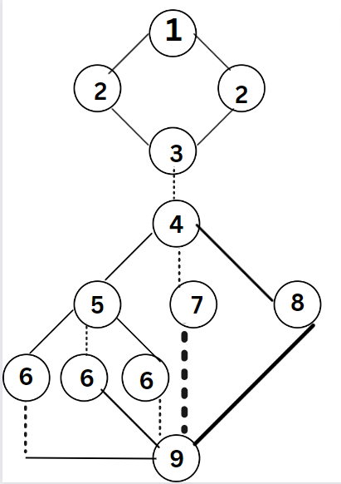
User Interface

Slide 21

ARCHITECTURE DIAGRAM:LOW LEVEL DIAGRAM DETAILS
User Interface: This component represents the user-facing interface of the calculator. It includes the forms, input fields, buttons, and other elements that allow users to enter their data and interact with the calculator.
Calculation Engine: The Calculation Engine is responsible for processing the user input and performing the necessary calculations to determine the carbon footprint. It may include various modules or algorithms for different types of calculations, such as energy usage, transportation emissions, or food consumption.
External Data Sources: This component represents external data sources that the calculator relies on for accurate calculations. It may include emissions factors databases, geocoding services, weather APIs, transportation data sources, and other relevant sources. The Calculation Engine interacts with these sources to retrieve specific data or factors needed for the calculations.

Slide 22
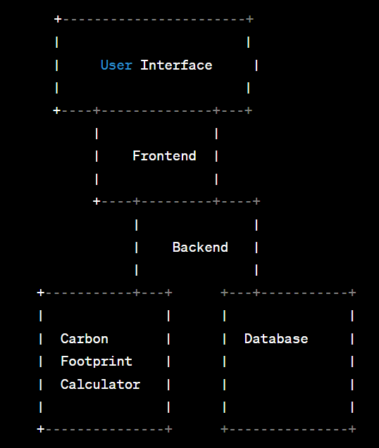
Architecture Diagram
User Interface: This component represents the visual interface that users interact with. It includes screens, forms, and other user interface elements.
Frontend: The frontend component handles the presentation logic and user interactions. It communicates with the backend to send and receive data.
Backend: The backend component handles the application logic and data processing.
Carbon Footprint Calculator : This component performs the calculations to determine the carbon footprint based on user inputs.
Database: The database component stores and manages the data related to user profiles, carbon footprint calculations, and other relevant information.

Slide 23
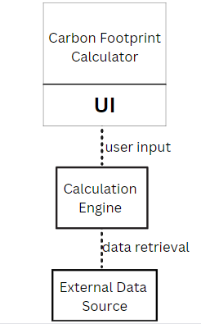
Low Level Design

Slide 24

Benefits of Agile for a Carbon Footprint Calculator:
The Agile model offers several benefits for developing a carbon footprint calculator:
Flexibility to Adapt: Since carbon footprint calculators may require continuous updates based on changing emission factors, regulatory standards, and user requirements, Agile allows for flexibility and quick adaptation to these changes.
Iterative Improvement: Agile's iterative nature enables frequent feedback loops, allowing the development team to improve the calculator's accuracy, user experience, and functionality with each iteration.
Customer Collaboration: Agile's emphasis on customer collaboration ensures that the calculator aligns closely with user needs. Regular feedback from customers or stakeholders helps refine and enhance the calculator's features and usability.
Early Value Delivery: Agile allows for the early delivery of functional increments, enabling users to start benefiting from the calculator even before its full development is complete.
Continuous Improvement: Agile fosters a culture of continuous improvement. The development team can gather insights from user feedback and make necessary adjustments to enhance the calculator's performance and relevance.
It's important to note that the Agile model may require active communication and collaboration among team members and stakeholders. Regular feedback loops and an iterative approach to development are essential for successful implementation.

Slide 25
Sample Code

Slide 26
public class CarbonFootprintCalculator {
public double calculateCarbonFootprint(double energyConsumption, double distance, double vehicleEfficiency, double wasteGenerated) {
// Calculation logic based on provided data
// Example calculations for energy, transportation, and waste emissions
double energyEmissions = energyConsumption * 0.45; // Assume emission factor of 0.45 metric tons CO2 per unit
double transportationEmissions = distance * vehicleEfficiency * 0.25; // Assume emission factor of 0.25 metric tons CO2 per km
double wasteEmissions = wasteGenerated * 0.1; // Assume emission factor of 0.1 metric tons CO2 per unit
double totalEmissions = energyEmissions + transportationEmissions + wasteEmissions;
return totalEmissions;
}
// Sample usage of the carbon footprint calculator
public static void main(String[] args) {
CarbonFootprintCalculator calculator = new CarbonFootprintCalculator();
double energyConsumption = 5000; // kWh
double distance = 1000; // km
double vehicleEfficiency = 0.08; // liters per km
double wasteGenerated = 2; // units
double carbonFootprint = calculator.calculateCarbonFootprint(energyConsumption, distance, vehicleEfficiency, wasteGenerated);
System.out.println("Your carbon footprint is: " + carbonFootprint + " metric tons CO2");
}
}

Slide 27
Result

Slide 28
The calculated carbon footprint of “X” metric tons CO2 serves as a quantitative measure of the user's environmental impact. This result emphasizes the importance of individual activities, such as energy consumption, transportation choices, and waste generation, in contributing to carbon emissions.
The discussion surrounding the obtained carbon footprint can focus on various aspects. Firstly, it can highlight the major contributors to the user's carbon footprint. For instance, if energy consumption constitutes a significant portion of the footprint, the discussion can revolve around exploring energy-saving strategies like adopting renewable energy sources or implementing energy-efficient technologies.
Additionally, the calculated carbon footprint prompts users to reflect on their transportation habits and explore options for reducing emissions in this area. This may involve considering alternatives such as using public transportation, carpooling, or opting for electric vehicles with lower emissions.
The discussion can also address waste generation and its environmental implications. Users can explore waste reduction strategies like recycling, composting, or minimizing single-use items to lower their carbon footprint.
Comparing the calculated carbon footprint to benchmarks or average emissions can provide users with context. This comparison helps users understand how their carbon footprint compares to others and encourages a sense of accountability and motivation for further reductions.
The carbon footprint result and subsequent discussion aim to raise awareness about the user's impact on climate change and promote sustainable behaviors. It empowers individuals to make informed decisions and take concrete actions to reduce their carbon footprint, ultimately contributing to the global effort to mitigate climate change and promote environmental sustainability.

Slide 29
Conclusion

Slide 30
The carbon footprint calculator is a valuable tool for individuals, businesses, and organizations to measure and understand their environmental impact. By calculating the carbon footprint based on factors like energy consumption, transportation habits, and waste generation, users gain insight into their contribution to carbon emissions and climate change.
The results obtained from the carbon footprint calculator provide a quantitative measure of one's environmental impact, emphasizing the significance of individual actions in shaping the global carbon footprint. The discussion surrounding the results encourages users to reflect on their energy usage, transportation choices, and waste management practices, opening the door to exploring sustainable alternatives and adopting eco-friendly behaviors.
Through personalized recommendations and educational resources, the calculator empowers users to take actionable steps towards reducing their carbon footprint. It provides guidance on energy conservation, sustainable transportation options, waste reduction strategies, and other environmentally friendly practices. By implementing these recommendations, users can contribute to mitigating climate change and creating a more sustainable future.
The carbon footprint calculator serves as a catalyst for raising awareness and fostering a sense of responsibility towards the environment. By comparing the calculated carbon footprint to benchmarks or average emissions, users can gauge their progress and set goals for further reductions. This helps create a culture of sustainability and encourages ongoing efforts to minimize environmental impact.
In conclusion, the carbon footprint calculator plays a crucial role in promoting environmental consciousness, empowering individuals and organizations to make informed decisions, and contributing to the global endeavor of combating climate change. By utilizing this tool, users can actively participate in building a more sustainable and resilient world for future generations.

Slide 31


THANK YOU

